Slide 1
Solar Energy Forecasting Using Weather Data and ML methods Bradley Payne
Motivation
Electricity production contributes roughly 25% of yearly global greenhouse gas emissions (epa.gov 2018). As the world seeks to move to a carbon free future, alternative energy sources must be balanced into the grid.
Solar energy production is weather dependent and fluctuates throughout the day.
Objective Determine the amount of energy generated by a 100 KW solar array given the real weather data

Slide 2
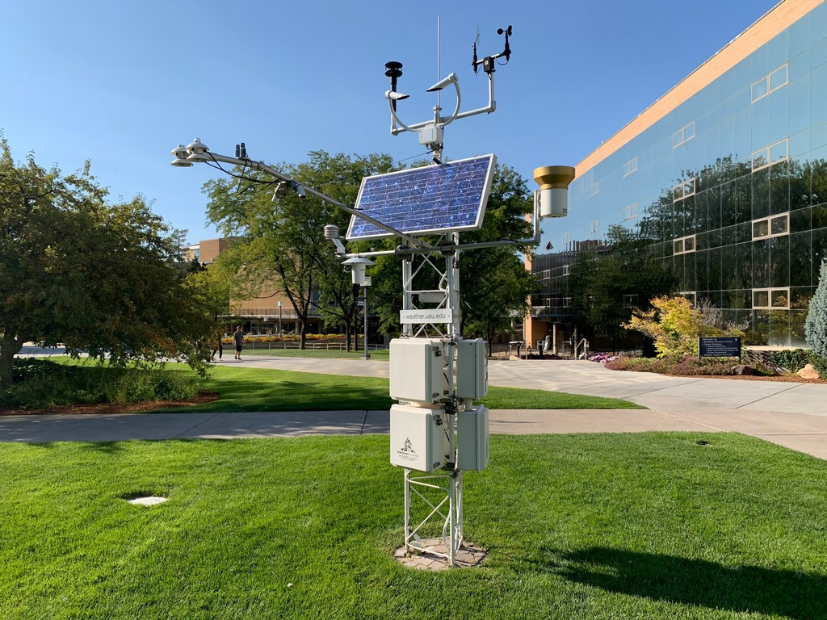

Problem Definition
Given
Historical weather data from USU Climate Center that contains 33 input variables including temperature, pressure, precipitation, clear sky radiation, humidity, etc.
Azimuth and Zenith angle of sun at each hour
Month and day of year encoded as coordinates
Solar Production data
Find
Average energy generated (KW) in the next hour, using data from 100 KW grid from Aspire labs for fitting

Slide 3
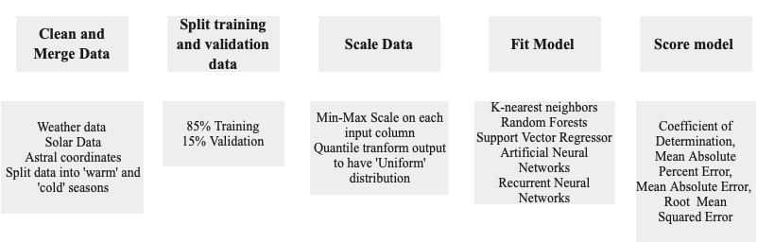
Methods

Slide 4
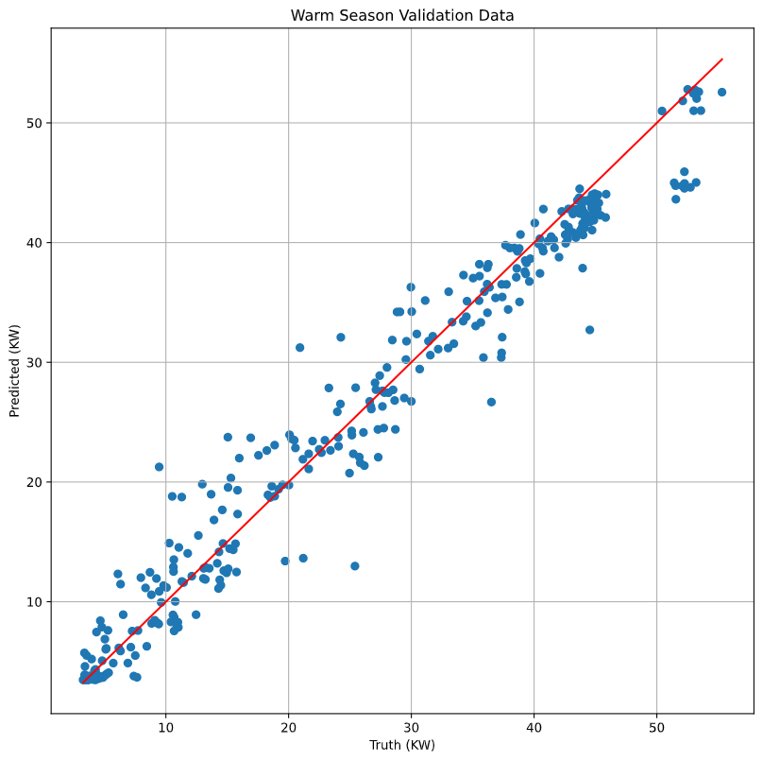
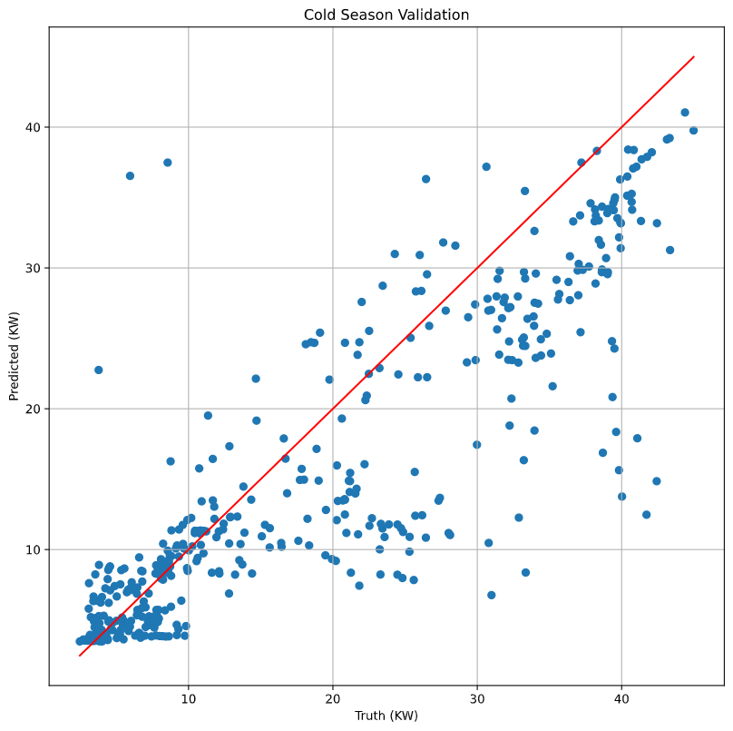
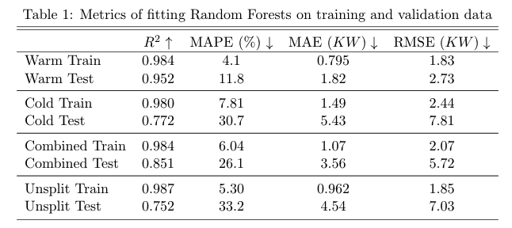
Results
Random forests performed best in every experiment
Mean absolute percent error (MAPE), mean absolute error (MAE), root mean squared error (RMSE)

Slide 5
Wrap-up & Conclusions
Summary
I used real solar production data and historical weather data to create a regression model that can predict solar generation during a given hour with a reasonable amount of error.
Conclusions
Random forests have superior generalization ability on this dataset
Scaling output data to a normal distribution helps the model to not underestimate generation during peak hours.
Fitting models based on seasons produces lower error than using a model fit on several.
Future work
Use weather forecasts instead of historical data to predict future generation
Integrate the generation and demand prediction to make an optimal energy use decision
All code, data, and a more detailed paper explaining this work can be found at https://github.com/bradley-p/Solar_Energy_Forecasting

